Slide 1

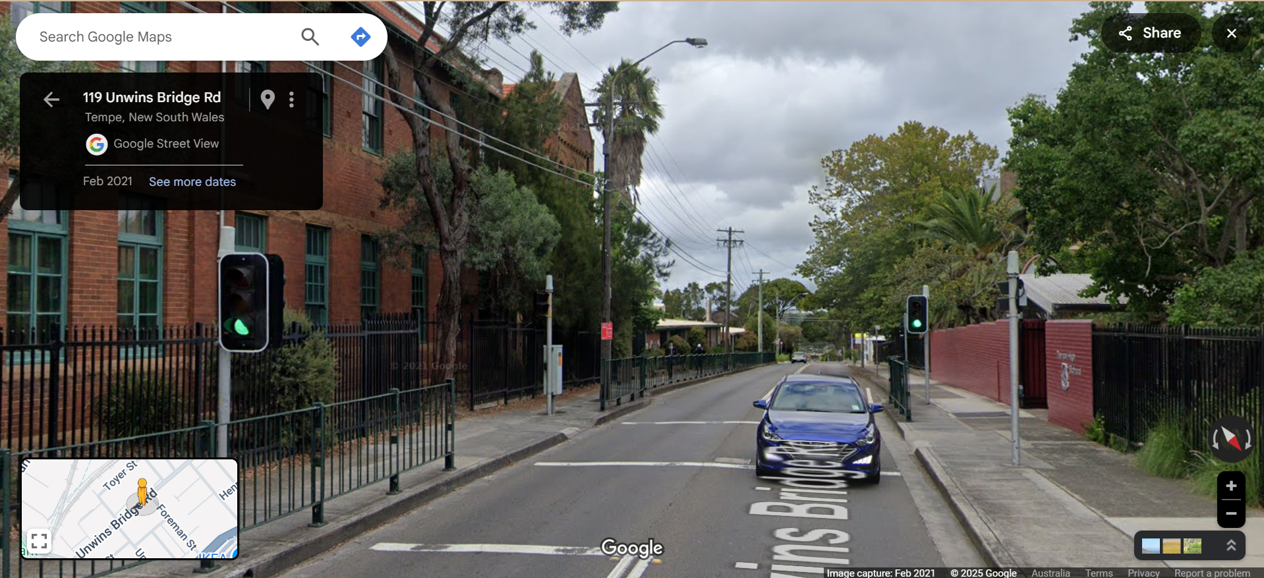

Pi Pico OOP Mini Project
Ben Jones
Tempe High School
Lecture 3
Notes:
Welcome to Lecture 2, we have nearly finished our LED Light Class.

Slide 2
Today
Abstraction
Non blocking methods
Complete and Unit Test Led_Light Class
Documentation
Notes:
Today we will explore
Abstraction
Non blocking methods
A Led_Light Class unit test
Documentation for the Led_Light Class

Slide 3
Abstraction
Abstraction in Object-Oriented Programming (OOP) is a principle that focuses on exposing only the essential features of an object while hiding the unnecessary details. The primary goal is to offer a simplified, high-level interface for interacting with complex systems, thereby making your code easier to use and understand.
What vs. How: Abstraction tells you what an object does, not how it does it.
Simplification: It reduces complexity by hiding implementation details.
Interface: Abstraction is often achieved by hiding the complex implementation and providing only the interface methods or attributes.
Notes:
Abstraction in Object-Oriented Programming (OOP) is a principle that focuses on exposing only the essential features of an object while hiding the unnecessary details. The primary goal is to offer a simplified, high-level interface for interacting with complex systems, thereby making your code easier to use and understand.

Slide 4
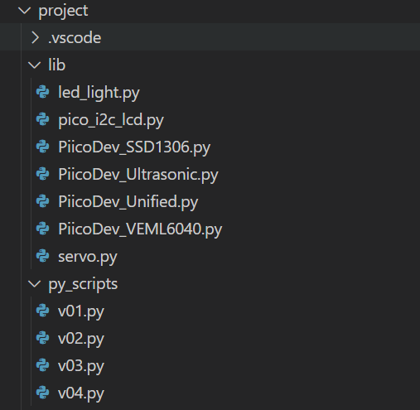
Create new files
v04.py in project\py_scripts\
led_light.py in project\lib\
Then copy the relevant imports and Class to led_light.py
Notes:
Let’s implement basic abstraction, create a file named led_light.py in the lib folder, where you will move your Led_Light Class as an abstraction, separate from your main program logic. Next, create a file named v04.py in the py_scripts folder, where you will import the library so you can access its interface.

Slide 5

Test the abstraction
from led_light import Led_Light
from time import sleep
red_light = Led_Light(3, True, True)
while True:
print(red_light.led_light_state)
red_light.led_light_state = 1
sleep(0.25)
print(red_light.led_light_state)
red_light.led_light_state = 0
sleep(0.25)
Notes:
The from led_light import Led_Light imports the interface and makes any public methods or attributes available to our main program logic. Make sure

Slide 6
Add a led_light_state time attribute
Class Led_Light(Pin):
# Sub Class inherits the Super 'Pin' Class
def __init__(self, pin, flashing=False, debug=False):
super().__init__(pin, Pin.OUT)
self.led_light_state
self.__debug = debug
self.__pin = pin
self.__flashing = flashing
self.__last_toggle_time = time()
Notes:
First, we need to add a new attribute to store the event time so we can compare it with the current time.

Slide 7
Create a .flash() method
def flash(self):
# Non-blocking flash: toggles LED every 0.5s for the given duration
now = time()
if self.__flashing and now - self.__last_toggle_time >= 0.5:
self.toggle()
self.__last_toggle_time = now
Notes:
Next, we’ll create a flash() method that should be called regularly. This method will compare the current time to the last time the LED was toggled. If at least 0.5 seconds have passed, it will toggle the LED. This approach is preferred for timing regular events in microcontroller programming because it avoids blocking the code with sleep statements, allowing the controller to continue handling other tasks.

Slide 8
Test the non blocking .flash() method
red_light = Led_Light(3, True, True)
while True:
red_light.flash()
print(1)
sleep(0.1)
Notes:
Now perform a unit test on our non-blocking method. It is important to point out that the microcontroller benefits from sleep(0.1) in the while True to allow the hardware to respond and improve timing.

Slide 9
Unit Test the Led_Light Class
Your unit test should test all methods, where possible, and you can consider using the self.value() method to automate the unit test.
Pause the video, design your unit test, then check your unit tests against my suggested batch of unit tests.
Notes:
Now its time for you to develop a comprehensive unit test for your Led_Light class. Your unit test should test all methods, where possible, and you can consider using the self.value() method to automate the unit test. Pause the video, design your unit test, then check your unit tests against my suggested batch of unit tests.

Slide 10
Add documentation to your Class
Class LedPico:
"""
Simple Class to turn an LED on or off on a Raspberry Pi Pico.
Args:
pin (int): GPIO pin number for the LED.
Example:
led = LedPico(25) # Onboard LED
led.set(True) # Turn on
led.set(False) # Turn off
"""
def __init__(self, pin):
from machine import Pin
self.led = Pin(pin, Pin.OUT)
def set(self, state: bool):
"""
Set the LED on or off.
Args:
state (bool): True to turn on, False to turn off.
"""
self.led.value(1 if state else 0)
Class-level docstring: Briefly describes what the Class represents and lists its attributes and methods.
Constructor docstring: Explains what parameters are needed to create an instance.
Method docstrings: Describe what each method does and what parameters it takes.
Notes:
Using this example as a guide, write developer documentation for your Led Light class. Your documentation should focus on describing the purpose and intent of each method, rather than explaining its implementation details. For example, “Turn the LED on. Overrides the Pin.on() method to provide additional debug output.” is good documentation because it explains why the method exists and what it achieves. In contrast, “Set pin high or low” is less helpful, as it simply describes what the code does—something that’s obvious from reading the method itself. Always aim to communicate the purpose and reasoning behind your methods in your documentation.

Slide 11
